Slide 1

Apache PIG

Slide 2
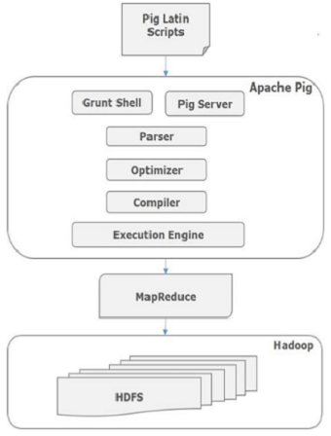
PIG Overview
Pig is a platform for transform large data sets
Pig scripts written in Pig Latin – an easy to learn scripting type of language
Pig uses MR, Pig scripts gets converted into optimized MR Jobs
Every task which can be achieved using PIG can also be achieved using java implementing in Map reduce

Slide 3
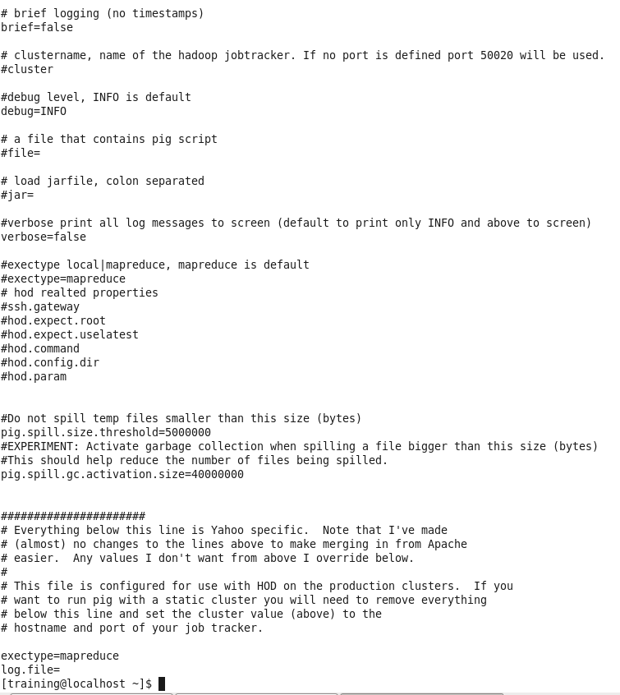
Pig Configuration
cat /etc/pig/conf/pig.properties
Pig.properties file has most of pig configurations which can be changed by root/ admin user of the cluster.
For example : See exectype = mapreduce. This sets Pig execution engine to Map Reduce. Alternatively You can use any other processing engine for pig like Tez.

Slide 4
Pig Execution modes
Local
Executes in a single JVM
Works exclusively with local file system
Great for development, experimentation and prototyping
Command to Start Pig in Local mode
pig –x local
Hadoop Mode
Also known as MapReduce mode. [ This is default mode ]
Pig renders Pig Latin into MapReduce jobs and executes them on the cluster
Can execute against semi-distributed or fully-distributed hadoop installation
Command to Start Pig in Hadoop mode
Simply do not specify any mode, It will start as default mode
pig

Slide 5
Pig Latin Building Blocks
Building blocks
Field - piece of data
Tuple - ordered set of fields, represented with ( )
Bag - Collection of tuples, represented with “{“ and”}”
Map - Key Value pair represented as key# value
Example
In RDBMS, An employee table contains records. Each record represents an employee. Each employee record describes an employee by employee id, name and age – which are fields
Similarly,
(100, “Joe Smith”, 30) is a Tuple with three fields employee Id, Name and Age.
Employee Table is a Bag as below which has two tuples
{(100, “joe Smith”, 30),(101, “Lee Chong”, “29”)}

Slide 6
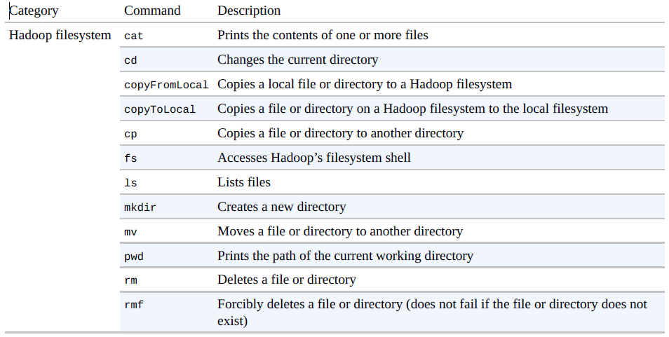
File System Commands supported in Grunt shell

Slide 7
Pig Functions
Load/Store Functions
Load Data Sets
Store Data Sets to HDFS
Filter Function
Filter records based on condition
Eval Functions
Evaluate values like, Sum, Average, Max, Count etc
Group By
Group by
Flattern
UDFs – User Defined Functions
Custom functions can be defined of either of three types – Load/Store, Eval or Filter

Slide 8
Diagnostic operator
Diagnostic operator supported by PIG.
DESCRIBE: Prints a relation’s schema.
EXPLAIN: Prints the logical, physical, and MapReduce execution plans of a relation.
ILLUSTRATE: Shows a sample execution of the logical plan.

Slide 9
Case Sensitivity
In the example below, note the following:
grunt> A = load 'data' USING PigStorage() AS (f1:int, f2:int, f3:int);
grunt> B = group A BY f1;
grunt> C = foreach B generate COUNT ($0);
grunt> dump C;
The names (aliases) of relations A, B, and C are case sensitive.
The names (aliases) of fields f1, f2, and f3 are case sensitive.
Function names PigStorage and COUNT are case sensitive.
Keywords LOAD, USING, AS, GROUP, BY, FOREACH, GENERATE, and DUMP are case insensitive. They can also be written as load, using, as, group, by, etc.

Slide 10
LOAD/STORE Dataset in PIG
A Pig Latin statement is an operator that takes a relation as input and produces another relation as output. This applies to all Pig Latin operators except LOAD and STORE command which read data from and write data to the file system.
Load Data Sets
cricData = load 'SampleDataFile/CricketScore.txt' using PigStorage('\t') as (pname:chararray,score:int,balls:int,six:int,four:int,minutes:int);
Display Dataset out on Console
DUMP cricData;
Store Datasets to HDFS
store cricData into 'output_pig/cricdata' using PigStorage(',');
Data Types in PIG
By default data type is bytearray in pig.
Complex types Data type: Tuple, Bag, Map
dispPlayer = foreach cricData generate (pname, score); // tuple construction
dump dispPlayer;
dispPlayer = foreach cricData generate {(pname, score)}, {pname, (balls/score)}; //bag construction
dump dispPlayer;
dispPlayer = foreach cricData generate [pname, score]; //MAP construction
dump dispPlayer;

Slide 11
PIG Relational Operators
Foreach generate - Generates data transformations based on columns of data.
A = FOREACH cricData GENERATE $0, $1, $1/$2*100 AS StrikeRate;
FILTER - Use the FILTER operator to work with tuples or rows of data
A = FILTER cricData BY score >= 50;
DISTINCT - Removes duplicate tuples in a relation.
A = DISTINCT (FOREACH cricData GENERATE $0); //Display unique player list
SPLIT - Partitions a relation into two or more relations.
SPLIT cricData INTO X IF $1 > 50, Y IF $1<= 50;

Slide 12
PIG Relational Operators
UNION - Computes the union of two or more relations.
A = UNION X,Y;
LIMIT - Limits the number of output tuples.
A = limit cricData 10; //To display only 10 records for sampling
SAMPLE - Selects a random sample of data based on the specified sample size.
A = SAMPLE cricData 0.01;
ORDER BY - Sorts a relation based on one or more fields.
A = ORDER cricData BY $0, $1 DESC;

Slide 13
PIG Relational Operators
GROUP BY - Groups the data in one or more relations.
A = GROUP cricData BY $0;
Describe A to see the schema
DUMP A;
Aggregate function with Group By.
B = FOREACH (GROUP(FOREACH cricData GENERATE $0,$1) BY $0) GENERATE $0, MAX($1.$1);
DUMP B;
Find Max Score of each player using GROUP;
a = load 'SampleDataFile/PlayerID_Name.csv' using PigStorage(',');
b = load 'SampleDataFile/playerID_Score_Balls.csv' using PigStorage(',');
c = group a by $0, b by $0;
dump c;
d = foreach c generate $1.$1, MAX($2.$1);
DUMP d;

Slide 14
PIG Relational Operators
COGROUP - Groups the data in one or more relations.
Find Max Score of each player using COGROUP;
a = load 'SampleDataFile/PlayerID_Name.csv' using PigStorage(',');
b = load 'SampleDataFile/playerID_Score_Balls.csv' using PigStorage(',');
c = cogroup a by $0, b by $0;
Note: In this case COGROUP is similar to full JOIN, For inner join,use KEYWORD “INNER” like below.
c = cogroup a by $0 INNER, b by $0 INNER;
dump c;
d = foreach c generate $1.$1, MAX($2.$1);
DUMP d;
Note: The GROUP and COGROUP operators are identical. Both operators work with one or more relations. For readability GROUP is used in statements involving one relation and COGROUP is used in statements involving two or more relations. You can COGROUP up to but no more than 127 relations at a time.

Slide 15
PIG Relational Operators
JOIN - Performs an inner join of two or more relations based on common field values. JOIN is equivalent to cogroup with flatten data as below.
a = load 'SampleDataFile/PlayerID_Name.csv' using PigStorage(',') as (pid,pname);
b = load 'SampleDataFile/playerID_Score_Balls.csv' using PigStorage(',') as (pid,score,balls);
INNER JOIN
c = JOIN a by $0, b by $0;
dump c;
Internally PIG will execute the JOIN statement like below.
X = FOREACH (COGROUP a BY $0 INNER, b BY $0 INNER) GENERATE FLATTEN(a), FLATTEN(b);
dump X; // The output of X will be same as output of c
LEFT OUTER JOIN
c = JOIN a by $0 LEFT OUTER, b BY $0;
RIGHT OUTER JOIN
c = JOIN a BY $0 RIGHT, b BY $0;
FULL OUTER JOIN
c = JOIN a BY $0 FULL, b BY $0;

Slide 16
Eval Functions
LOAD the cric data and apply GROUP.
cricData = load 'SampleDataFile/CricketScore.txt' using PigStorage('\t') as (pname:chararray,score:int,balls:int,six:int,four:int,minutes:int);
groupData = GROUP cricData BY pname;
AVG (Computes the Average of score)
avgScore = FOREACH groupData GENERATE group, AVG(cricData.score);
MAX (Computes the maximum of the Score)
maxScore = FOREACH groupData GENERATE group, MAX(cricData.score);
MIN – (Computes the minimum of the Score).
minScore = FOREACH groupData GENERATE group, MIN(cricData.score);
SUM (Computes the total score of each player)
totalScore = FOREACH groupData GENERATE group, SUM(cricData.score);

Slide 17
Replicate Join
Replicate join is a special type of join that works well if one or more relations are small enough to fit into main memory. In such cases, Pig can perform a very efficient join because all of the hadoop work is done on the map side. In this type of join the large relation is followed by one or more small relations. The small relations must be small enough to fit into main memory; if they don't, the process fails and an error is generated.
big = LOAD 'big_data' AS (b1,b2,b3);
tiny = LOAD 'tiny_data' AS (t1,t2,t3);
mini = LOAD 'mini_data' AS (m1,m2,m3);
C = JOIN big BY b1, tiny BY t1, mini BY m1 USING 'replicated';
Note large relation comes first followed by the smaller relations;
Replicate joins are experimental; Apache PIG don't have a strong sense of how the small relation must be to fit into memory. According to tests, with a simple query that involves just a JOIN, a relation of up to 100 M can be used if the process overall gets 1 GB of memory.

Slide 18
Skewed Joins
Parallel joins are vulnerable to the presence of skew in the underlying data. If the underlying data is sufficiently skewed, load imbalances will swamp any of the parallelism gains. In order to counteract this problem, skewed join computes a histogram of the key space and uses this data to allocate reducers for a given key. Skewed join does not place a restriction on the size of the input keys. It accomplishes this by splitting the left input on the join predicate and streaming the right input. The left input is sampled to create the histogram.
Skewed join can be used when the underlying data is sufficiently skewed and you need a finer control over the allocation of reducers to counteract the skew. It should also be used when the data associated with a given key is too large to fit in memory.
A = LOAD 'skewed_data' AS (a1,a2,a3);
B = LOAD 'data' AS (b1,b2,b3);
C = JOIN A BY a1, B BY b1 USING 'skewed';
conditions:
Skewed join works with two-table inner and outer join. Currently PIG do not support more than two tables for skewed join.
The skewed table must be specified as the left table. Pig samples on that table and determines the number of reducers per key.

Slide 19
Merge Join
Often user data is stored such that both inputs are already sorted on the join key. In this case, it is possible to join the data in the map phase of a MapReduce job. This provides a significant performance improvement compared to passing all of the data through unneeded sort and shuffle phases.
Pig has implemented a merge join algorithm, or sort-merge join. It works on pre-sorted data, and does not sort data for you.
C = JOIN A BY a1, B BY b1, C BY c1 USING 'merge'; //Merge Joins works on pre-sorted data.
Condition
No other operations can be done between the load and join statements.
Data must be sorted on join keys in ascending (ASC) order on both sides.

Slide 20
String Functions
UPPER - Returns a string converted to upper case.
Syntax - UPPER(expression)
LOWER - Converts all characters in a string to lower case
Syntax - LOWER(expression)
TRIM - Returns a copy of a string with leading and trailing white space removed.
Syntax - TRIM(expression)
LTRIM - Returns a copy of a string with only leading white space removed.
Syntax - LTRIM(expression)
RTRIM - Returns a copy of a string with only trailing white space removed.
Syntax - RTRIM(expression)
SUBSTRING - Returns a substring from a given string.
Syntax - SUBSTRING(string, startIndex, stopIndex)

Slide 21
PIG with HCatalog
The HCatLoader and HCatStorer interfaces are used with Pig scripts to read and write data in HCatalog-managed tables.
To bring in the appropriate jars for working with HCatalog, simply include the below.
pig -useHCatalog
records = LOAD ' cricdb.cricdata' USING org.apache.hive.hcatalog.pig.HCatLoader();
You must specify the table name in single quotes: LOAD 'tablename'. If you are using a non-default database you must specify your input as 'dbname.tablename'.
describe records;
dump records;
store records into 'cricdb.cricdata_pig' using org.apache.hive.hcatalog.pig.HCatStorer();
While storing The schema should be same as target hive table schema

Slide 22
PIG macro
To create a macro
DEFINE myfilter(a, b, val) returns x { $x = filter $a by $b >= $val; };
Above defines a Pig macro.
To use macro
cricData = load 'SampleDataFile/CricketScore.txt' using PigStorage('\t') as (pname:chararray,score:int,balls:int,six:int,four:int,minutes:int);
a = myfilter(cricData,score,30); // This will use macro to filter players with score more than 30.
To use this macro as external macro in script, Save above code as ‘samplemacro.pig’
Add the following to use macro in PIG Script.
IMPORT 'code/pig/samplemacro.pig'; // IMPORT the macro definitions to the calling pig script
cricData = load 'SampleDataFile/CricketScore.txt' using PigStorage('\t') as (pname:chararray,score:int,balls:int,six:int,four:int,minutes:int);
A = myfilter(cricData,score,50);
Note the following restrictions:
Macros are not allowed inside a FOREACH nested block.
Macros cannot contain Grunt shell commands like ls, cat etc.

Slide 23
UDF
Pig provides extensive support for user defined functions (UDFs) to specify custom processing.
Type of UDFs
Eval Functions
Filter Functions
Load Functions
Store Functions
CREATE a maven package in eclipse/IntelliJ like com.programs.PIGUDF and create jar.
This UDF example is to accept any name and convert it to uppercase and prefix it with “MR”
It can be used in FOREACH statements as shown in this below PIG script:
register jar/Hadoop-1.0-SNAPSHOT.jar
cricData = load 'SampleDataFile/CricketScore.txt' using PigStorage('\t') as (pname:chararray,score:int,balls:int,six:int,four:int,minutes:int);
A = foreach cricData generate com.programs.PIGUDF.GreetingsName(pname);
DUMP A;

Slide 24
Piggybank
Piggybank is a jar and its a collection of user contributed UDF’s that is released along with Pig.
The Piggy Bank is a place for Pig users to share their functions.
Download link for jar:
https://mvnrepository.com/artifact/org.apache.pig/piggybank
List of UDFs
https://pig.apache.org/docs/r0.17.0/api/org/apache/pig/piggybank/

Slide 25
PIG Parameter substitution
Create Script ‘cricdata.pig’ with below code. //EXERCISE to Students
First find out player’s data who scored more than 50.
Find players strike rate (score/balls * 100)
Rate them to a category as below
Strike rate less than 50 - AVERAGE
Strike rate between 50 to 100 - GOOD
Strike rate more than 100 - GREAT
supply the input file and outout path at runtime.
Verify the script “cricdata.pig” for solutions.
pig -param inputFile=SampleDataFile/CricketScore.txt -param OutPut=pig_output/cricdata code/pig/cricdata.pig
Exec Vs. Run. (From grunt shell)
RUN command executes the script in the same shell, hence can be used for debugging each relation.
run -param inputFile=SampleDataFile/CricketScore.txt -param OutPut=pigout/cricdata_run code/pig/cricdata.pig //Maintains relation to debug
EXEC command internally executes the script in a background shell and returns the result, hence can’t be used for debugging.
exec -param inputFile=SampleDataFile/CricketScore.txt -param OutPut=pigoutput/cricdata_exec code/pig/cricdata.pig

Slide 26
Performance Tuning
PIG uses Lazy Execution. Pig Latin interpreter confirms that statements are syntactically correct and adds it to the logical plan, but it does not load the data. When Dump or store is used, the logical plan is compiled into a physical plan and executed to enhance MR program.
Project early and often //Remove unnecessary columns before joins
Filter Early and Often //Remove unwanted data before join than after join.
Remove null values before join. when the nulls are flattened we're guaranteed to have an empty bag, which will result in no output but go toa single reducer.
set the number of reduce tasks for the MapReduce jobs generated by Pig using parallel reducer feature.
SET default_parallel 20; MapReduce jobs gets launched use 20 reducers.
B = GROUP cricData BY $0;
B = GROUP cricData BY $0 PARALLEL 20;
Use Joins appropriately - Skewed Vs. Replicated vs. Merge join.

